Slide 2
Facilitator
Starlady’s contact details:
Email: starlady@zbgc.org.au
Mobile: 0429070827
Starlady (she/her)
Program Manager
Zoe Belle Gender Collective (ZBGC)
Starlady is the program manager of the Zoe Belle Gender Collective, a trans and gender diverse advocacy organization based in Victoria. Starlady is the lead author, community consultant and manager of the ZBGC’s prevention of men’s violence against trans women campaign Transfemme. She sits on the Victorian State Governments Trans & Gender Diverse Expert Advisory Group and delivers training and education across Victoria to health and human services promoting trans and gender diverse inclusive practice, including family violence and gender equity services..

Slide 3
Panelist
Carolina
Survivor advocate (she/her)
Amao
Survivor advocate (she/her)
Sasja
Survivor advocate (she/her)
An emerging trans activist interested in educating people about the experiences of transgender women in Muslim countries, especially the Middle East, and how they have been impacted by family and state based violence.
A community advocate, consultant and a performance artist who’s work focusses on weaving the tapestry of intersectionality of race, culture and gender.
A trans woman of colour activist, advocate, feminist who works towards advocating for community and self-love, with an empowering message of moving beyond gender expectations to live more authentically.

Slide 4
Panelist’s key messages
The community consultation held to develop Transfemme found that trans woman who hook up, date or are in relationships with cis men may experience;
increased risk of sexual violence, intimate partner violence or family/community violence.
pressure to be hyper feminine.
coercion and control in regards to their bodies and medical affirmation.
challenges in accessing public relationships or pressure from their partner not to disclose their trans identity/experience.
challenges in disclosing their trans identity, history or experience to their partner or their partners family, friends or broader community.
men’s poor consent practices & sexual exploitation.
objectification and fetishisation based upon their gender identity, bodies, skin color, race or ethnicity.

Slide 5
Panelist’s key messages
ZBGC encourages family violence services to:
sensitively screen trans women accessing your services for the experiences described in Transfemme (above) and advocate for a practice guide/tip sheet to be developed for family violence practitioners
engage the ZBGC in training on Transfemme and learn more about the drivers of violence against trans women and their experiences of intimate partner violence
consult with LGBTIQA+ specialist services and capacity building programs
develop strong relationships with trans and gender diverse advocacy organisations and community groups
develop resources that feature and represent the experiences of trans women
employ trans women and develop peer led programs that engage in outreach
engage with sex work advocacy organisations such as Vixen or Rhed
develop men’s behaviour programs and resources that address men’s violence against trans women
consider and prioritise the intersectional experiences of trans women of color across these recommendations.

Slide 6
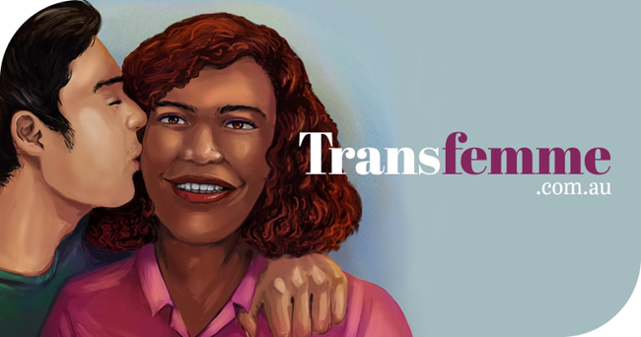
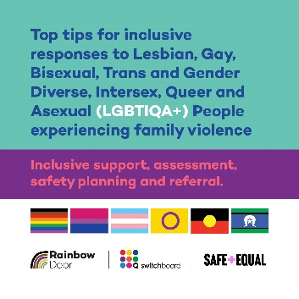
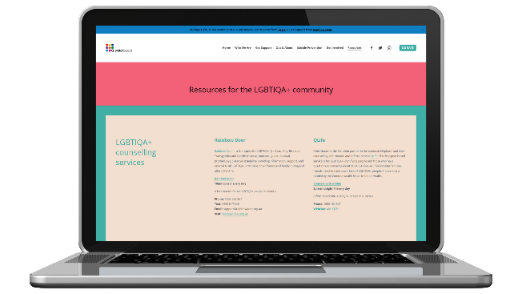
Resources to support your practice
Transfemme
A web resource containing stories, tips and resources to support healthier relationships between trans women and men.
Visit transfemme.com.au
Tip sheet to help practitioners responding to family violence provide LGBTIQA+ inclusive support
A tip sheet to help practitioners responding to family violence provide LGBTIQA+ inclusive support, assessment, safety planning and referral.
Visit Safe and Equal’s resource Library
Switchboard Resources
Resources for the LGBTIQA+ community, including counselling services and resources for youth and families.
Visit the Switchboard website.

Slide 7
Thank you

