Slide 1
‘How We Thrive’ Video Series Launch Webinar
Hannah Dwyer, Prevention Program Officer, Safe and Equal

Slide 2
Acknowledgment of Country

Slide 3
Agenda and Housekeeping
This webinar is being recorded
Live captioner ​and Auslan interpreter with us today
Please use the Q&A function for questions
We would like this space to be respectful and safe for all attendees and speakers, so please consider this as you ask questions and use the chat box.

Slide 4
Support Services
1800 RESPECT (1800 737 732) is the national 24/7 family, domestic violence and sexual assault counselling service. 1800 RESPECT also provides online counselling support, and a range of additional resources, through their website. ​
Safe Steps (1800 015 188) is Victoria’s statewide family violence crisis service for women, young people and children experiencing family violence. ​
In an emergency, call triple zero (000). ​

Slide 5
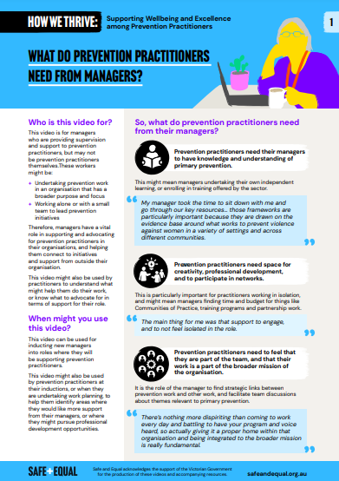
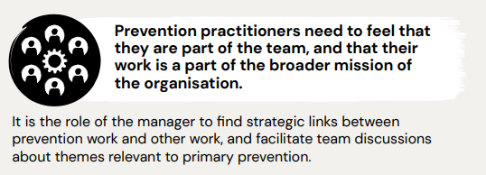
Presenters
Picture

Slide 6
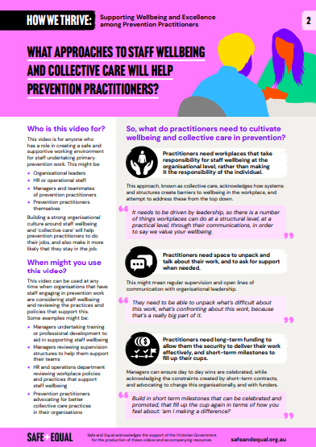
Picture

Slide 7
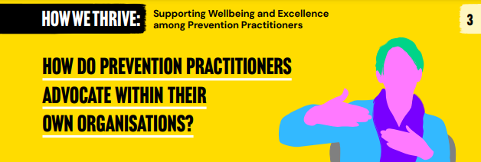
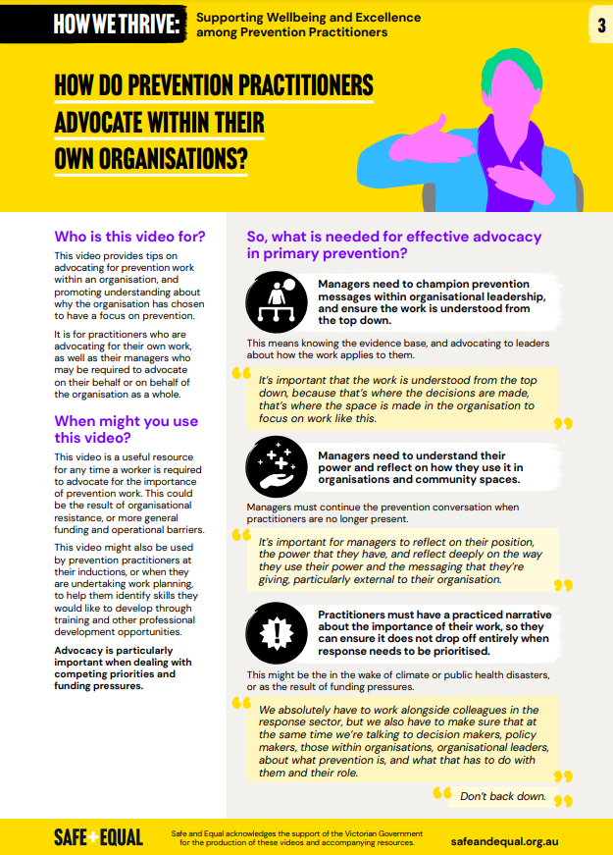
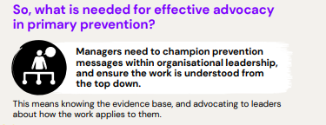
Name
Title/organisation

Slide 8
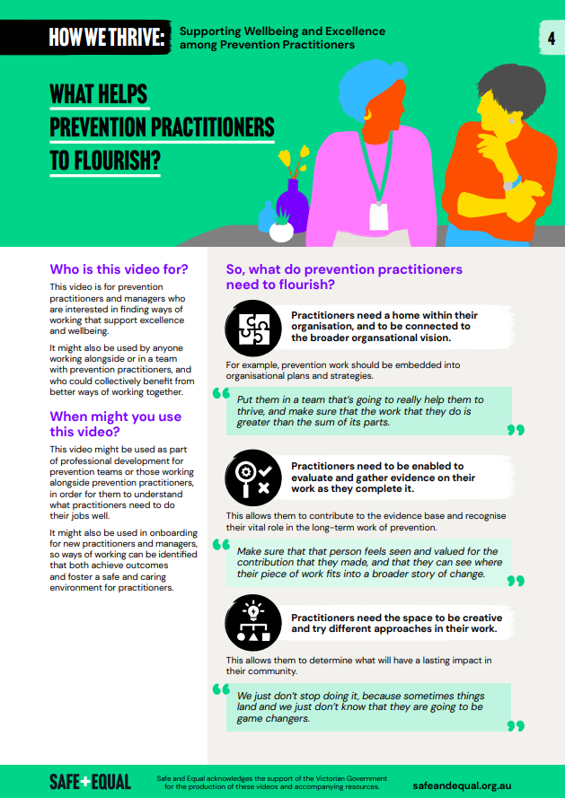

Slide 9
How We Thrive trailer

Slide 10
Questions

Slide 11
Thank you Please take three minutes to complete the evaluation survey

