Slide 1


Slide 2





Slide 3
Agenda and Housekeeping
This webinar is being recorded.
We won’t have a break so please look after yourself and step away if needed.
We have a live captioner ​and Auslan interpreter with us today​.
Please use the Q&A function for questions.
We would like this space to be respectful and safe for all attendees and speakers, so please consider this as you ask questions in the chat function.

Slide 4
Support Services
1800 RESPECT (1800 737 732) is the national 24/7 family, domestic violence and sexual assault counselling service.
Safe Steps (1800 015 188) is Victoria’s statewide family violence crisis service anyone experiencing family violence.
Sexual Assault Crisis Line (1800 806 292) is Victoria’s statewide crisis service for anyone who has experienced sexual assault.
Rainbow Door (1800 729 367) is a free service for all LGBTIQ+ people in Victoria, their friends, family and peers.
Yarning Safe and Strong (1800 959 563) is a free and confidential counselling service for Aboriginal and Torres Strait Islander Peoples
In an emergency, call triple zero (000)

Slide 5
We recognise the strength and resilience of those impacted by violence.
We honour the strength and resilience of adults, children and young people who have experienced family violence and sexual assault and recognise that it is essential that responses to and prevention of family violence and sexual violence are informed by their expert knowledge and advocacy.
We pay respects to those who have not survived and acknowledge the lasting impacts of this preventable violence on families and communities. ​

Slide 6

Introduction to
Victorian Affirmative
Consent Reforms
Dr Amy Webster
Policy, Advocacy & Research Manager
Sexual Assault Services Victoria​

Slide 7
Legislative Reforms
Justice Legislation Amendment (Sexual Offences and Other Matters) Act 2022
These legislative reforms were made in response to the Victorian Law Reform Commission report - Improving the Justice System Response to Sexual Offences.
The consent reforms will come into operation on 30 July 2023.
Disclaimer: This information is intended as a general overview only. The contents do not constitute legal advice, are not intended to be a substitute for legal advice and should not be relied upon as such.

Slide 8
What are the new affirmative consent laws?
Updated definition of consent.
Introduction of affirmative sexual consent model.
Additions to circumstances where there is no consent.
Inclusion of non-consensual condom tampering or removal.
Changes to image-based sexual abuse laws.
Improvements to the justice system to better protect victim survivors, including increased education and direction for members of a jury to understand sexual violence.

Slide 9


Introduction of Affirmative Sexual Consent Model
A person must take steps to say or do something to check that the other person(s) involved are consenting to a sexual activity, rather than rely on the other person to give their consent.
Is this okay?
Aims to place greater focus on the actions of the person using sexual violence, rather than on the victim survivor.
What are your boundaries?

Slide 10
How the definition of consent has changed
A 'free and voluntary agreement’.
This reinforces that involuntary bodily responses are not an indication of consent.
A person does not consent merely because they do not resist verbally or physically.
This moves away from outdated notions of lack of consent, which is based on the amount of resistance rather than something that is positively communicated.
A person does not consent just because of previous sexual behaviour.
Consent can not be assumed based on past sexual behaviours.

Slide 11

Changes to: Objectives
To uphold the fundamental right for every person to make decisions about their sexual behaviours and to choose not to engage in sexual activity.
NEW OBJECTIVE ADDED:
ab. To promote the principle that consent to an act is not to be assumed - that consent involves ongoing and mutual communication and decision making between each person involved (that is, each person should seek the consent of each other person in a way and at a time that makes it clear whether they consent)

Slide 12
Changes to: Circumstances where there is no consent
Force, harm or fear of any type - including more subtle types of harm including emotional manipulation and economic abuse.
Abuse of a relationship of trust and authority.
Non-payment of sex workers in fraudulent circumstances a circumstance where there is no consent.
Intentional non-use, removal or tampering of a condom without consent ('stealthing').

Slide 13
Changes to: Reasonable belief in consent
Under the new Victorian law, the accused/defendant will need to demonstrate that they had a reasonable belief that another person was consenting.
Requirement does not apply if the person has a cognitive impairment or mental illness (other than the effects of self-induced intoxication) that was a substantial cause of them not saying or doing anything to find out if the other person consents. This protects people who may have compromised communication skills because of their impairment or illness
A belief is not reasonable if, within a reasonable time before or at the time the act takes place, the person does not say or do anything to find out whether the other person consents.
Requirement does not apply if the person has a cognitive impairment or mental illness (other than the effects of self-induced intoxication) that was a substantial cause of them not saying or doing anything to find out if the other person consents. This protects people who may have compromised communication skills because of their impairment or illness

Slide 14
New provisions: Image-based sexual abuse
Young people under 18 years cannot legally consent to sharing and distribution of intimate images.
If you are under 18 years, it is not considered illegal for you to take or keep intimate images of yourself or someone else, if:
          No one in the image is more than 2 years younger than you.
          The image does not show a crime being committed.

Slide 15
Supporting Young People to Understand
Affirmative Consent Program (2022 - 2024)
  12 projects across Victoria, funded by Department of Families, Fairness and Housing.
  Program aims to support young people to develop an early understanding of affirmative consent and how they can and must seek consent when engaging in sexual activities.
  Young people, 12-25 years, in out of school settings.

Slide 16
Program Objectives
  Educate young people about Victoria's new legislative reforms.
  Raise awareness around consent, as well as different forms and common misconceptions of sexual violence.
  Build evidence of what works to promote affirmative consent and prevent sexual violence in specific communities and settings.

Slide 17
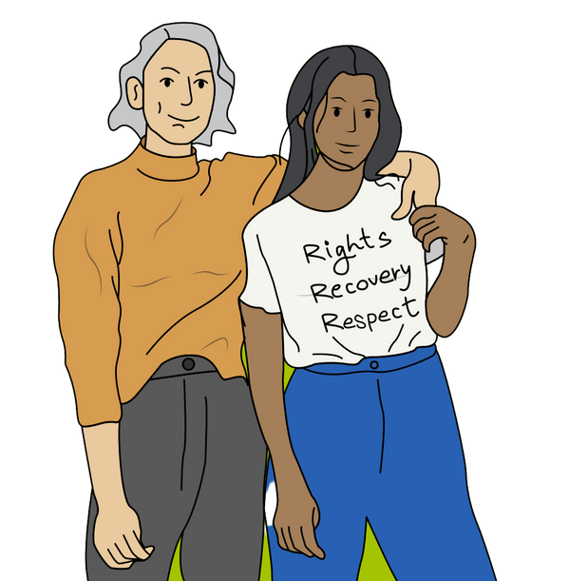
Thank you!

Slide 18


Questions

Slide 19
Thank you

